Slide 1

Department of Information and Communication Technology Course Code : ICT-3201
Course Name: Computer Networks
Presentation Topic: HTTP/3 Network Protocol
Presented By:
Abu Sayem (ID: IT-22008)
Project Superviser:
Dr. Nazrul Islam
Associate professor,
Dept. of ICT
Mawlana Bhashani Science and Technology University ,Tangail

Slide 2
Welcome to the Presentation Contents:
Identity of HTTP and its evolution
Why we need HTTP/3?
Key features of HTTP/3
Core components of HTTP/3
Working mechanism of HTTP/3
Advantages of HTTP/3
Disadvantages of HTTP/3
Applications of HTTP/3
Future scope and challenges
Conclusion

Slide 3
Introduction of HTTP
HTTP stands for HyperText Transfer Protocol.
It’s the protocol that browsers and servers use to communicate and exchange web data.
HTTP Evolution:
HTTP/1.1: Oldest widely-used version; simple but slow for modern websites.
HTTP/2: Faster, supports multiplexing (multiple requests at once) over a single TCP connection.
HTTP/3: Latest version, even faster and more secure, based on QUIC instead of TCP.

Slide 4
Why HTTP/3?
Problems in HTTP/2 / TCP:
Head-of-Line Blocking: If one packet is lost, all other requests wait until it is retransmitted.
Slow connection establishment: TCP + TLS handshakes take time.
Modern web demands:
Faster page loads, low latency for video/games.
Mobile-friendly: handle switching networks (Wi-Fi → mobile data).
Solution: HTTP/3 fixes these issues using QUIC.

Slide 5
Key features of HTTPS/3
Built on QUIC Uses QUIC transport protocol over UDP instead of TCP
Eliminates Head-of-Line Blocking Independent streams prevent packet loss in one stream from blocking others
Faster Connection Setup 0-RTT and 1-RTT handshakes reduce latency significantly
Mandatory Encryption TLS 1.3 is built directly into the protocol
Improved Mobility Connection migration maintains sessions when switching networks

Slide 6
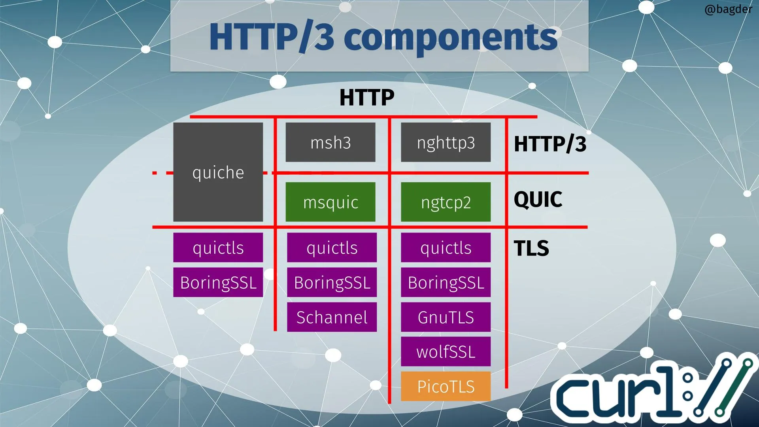
Core Components of HTTP/3
HTTP/3 Layer
Manages web requests & responses
Uses streams for multiplexing
Examples: msh3, nghttp3
QUIC Transport Layer
Built on UDP protocol
Prevents head-of-line blocking
Examples: msquic, ngtcp2
TLS Security Layer
Provides mandatory encryption
Integrated with QUIC protocol
Examples: BoringSSL, GnuTLS

Slide 7
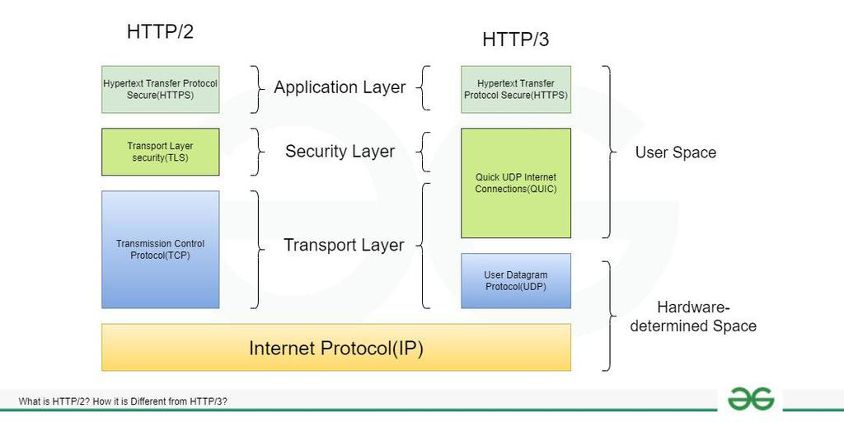
How HTTP/3 works

Slide 8
Explaining the HTTP/2 Stack (Left Side)
This is the "traditional" modern web stack.
Application Layer: HTTP/2
This is the protocol your browser and server use to communicate. HTTP/2 introduced major performance improvements over HTTP/1.1, like multiplexing (sending multiple files at once over a single connection).
Security Layer: TLS (Transport Layer Security)
This is the protocol that provides encryption (the "S" in HTTPS). It runs on top of TCP and creates a secure tunnel before any HTTP data is sent.
Transport Layer: TCP (Transmission Control Protocol)
This is the core transport protocol of the internet. It ensures all data packets are delivered reliably and in the correct order. It requires a "handshake" to establish a connection.
Network Layer: IP (Internet Protocol)
This handles the addressing and routing of packets across the internet.

Slide 9
Explaining the HTTP/3 Stack (Right Side)
This is the new architecture designed to fix TCP's limitations.
Application Layer: HTTP/3
Functionally, it's very similar to HTTP/2 (multiplexing, headers compression, etc.). The key difference is that it's re-engineered to run on top of QUIC instead of TCP.
Transport Layer: QUIC (Quick UDP Internet Connections)
This is the revolutionary change. QUIC is a modern transport protocol that combines the roles of TCP and TLS.
It's built on UDP, a lighter-weight protocol than TCP.
It has TLS encryption built-in by design. You cannot have unencrypted QUIC.
It handles its own reliable, in-order delivery per stream.

Slide 10
Advantages of HTTP/3
Faster Connections Combines transport and security handshakes, enabling 0-RTT or 1-RTT connection resumption.
Eliminates Head-of-Line Blocking Uses QUIC streams so packet loss in one stream doesn’t block others.
Better Performance on Unreliable Networks Handles network changes seamlessly — ideal for mobile devices.
Built-in Security TLS 1.3 encryption is mandatory, enhancing privacy by default.

Slide 11
Disadvantages of HTTP/3
Limited Adoption & Support Not all servers, clients, and network equipment fully support HTTP/3 yet.
Complex Deployment Requires QUIC implementation, which is more complex than TCP/TLS setup.
Firewall & Middlebox Issues Some networks block UDP or QUIC traffic, causing connectivity problems.
Higher CPU Usage Encryption and QUIC processing can consume more server resources.

Slide 12
Applications of HTTP/3
Web Browsing Major browsers (Chrome, Firefox, Edge, Safari) use HTTP/3 for faster page loads and better user experience.
Mobile Applications Ideal for apps requiring low latency and stable connections when switching between Wi-Fi and cellular networks.
Live Video Streaming Reduces buffering and improves quality in live streaming and video-on-demand services.
IoT and Real-time Communication Supports efficient data transfer for IoT devices and real-time apps like video conferencing and VoIP.

Slide 13
Future Scope and Challenges
Widespread Adoption Expected to become the default standard for web traffic, replacing HTTP/2 in most applications.
Enhanced Web Protocols Will enable new web standards and APIs to leverage its low-latency capabilities.
5G and Edge Computing Perfectly suited for 5G networks and edge computing, reducing latency for real-time applications.
IoT Expansion Could become the standard protocol for IoT devices due to its efficient multiplexing and security.

Slide 14
Conclusion
HTTP/3 marks a major leap in web technology by replacing TCP with the QUIC protocol. By integrating transport and encryption, it eliminates head-of-line blocking and drastically reduces connection times. This results in faster, more reliable web experiences, especially for mobile and real-time applications. Despite some deployment challenges, its growing adoption and performance benefits firmly establish HTTP/3 as the future standard for a faster, more secure internet.

Slide 15


